Slide 1

X Education - Lead Scoring Case Study:
Saydain sheikh
Aikantika acharya

Slide 2
Background :
X Education , An education company named sells online courses to industry professionals
Many interested professionals land on their website
The company markets its courses on several websites like Google. Once these people land on the website, they might browse the courses or fill up a form for the course or watch some videos
When these people fill up a form providing their email address or phone number, they are classified to be a lead
Once these leads are acquired, employees from the sales team start making calls, writing emails, etc. Through this process, some of the leads get converted while most do not
The typical lead conversion rate at X education is around 30%

Slide 3
Problem Statement:
X Education gets a lot of leads but its lead conversion rate is very poor
To make this process more efficient, the company wishes to identify the most potential leads, also known as ‘Hot Leads’
If they successfully identify this set of leads, the lead conversion rate should go up as the sales team will now be focusing more on communicating with the potential leads rather than making calls to everyone.
We will help them to select the most promising leads, i.e. the leads that are most likely to convert into paying customers.
We are required to build a model wherein we need to assign a lead score to each of the leads such that the customers with higher lead score have a higher conversion chance
The CEO, in particular, has given a ballpark of the target lead conversion rate to be 80%.

Slide 4
Lead-Conversion Process:
Lead Generation
Visit to X Education website by these potential customers (professionals)
Visitors either provide Email id & Contact Details
Or
View videos etc
Proposed Solution:
A model to filter leads so that leads to conversion ratio is 80%+
Telecalling and emailing activity to all the leads
30 % leads get converted

Slide 5
Proposed Solution
Communicating with Hot Leads
Conversion of Hot Leads
Selection of Hot Leads
We cluster the leads into certain categories based on their tendency or probability to convert, thus, getting a smaller section of hot leads to focus more on.
Since we would have a smaller set of leads to have communication with, we might make more impact with effective communication.
As we focussed on hot leads, which were more probable to convert, we would have a better conversion rate, and hence we can achieve the 80% target.

Slide 6
Solution
Selection of Hot Leads
For our Problem Solution, the crucial part is to accurately identify hot leads.
The more accurate we obtain the hot lead, the more chance we get of higher conversion ratio.
Since we have a target of 80% conversion rate, we would want to obtain a high accuracy in obtaining hot leads.

Slide 7



IMPLEMENTATION
Lead Clustering
Analysis and Modelling
Final Leads

Slide 8
Duplicate removal, null value treatment, unnecessary column elimination, etc.
Outlier Treatment, Feature-Standardization
Data Cleaning
Performing EDA
Data Gathering
Data Preparation
Model Building
Loading & Observing the past data provided by the Company
Performing exploratory data analysis to understand the correlation between features
Performing pre-requisites for RFE and Logistic Regression

Slide 9
Verifying our Final Model Accuracy with our Training model
Selection of top 15 features using RFE
Reduction of columns and Model re-building
Feature Selection
Model Building
Model Improvement
Final Model
Verifying our Final Model Accuracy
Model building using RFE for selected columns
Final Model Analysis and performance on Test Data

Slide 10
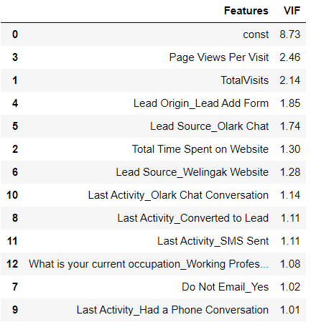
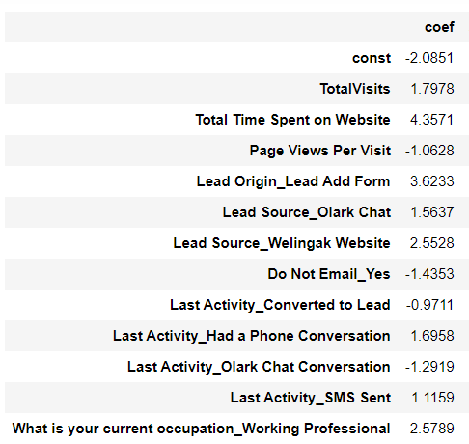
Features of Final Model:
** const is not considered, so our final features are the ones except “const”.
** The coefficients of the features to ensure positive and negative impact.

Slide 11



PLOTS(Visualizations)

Slide 12
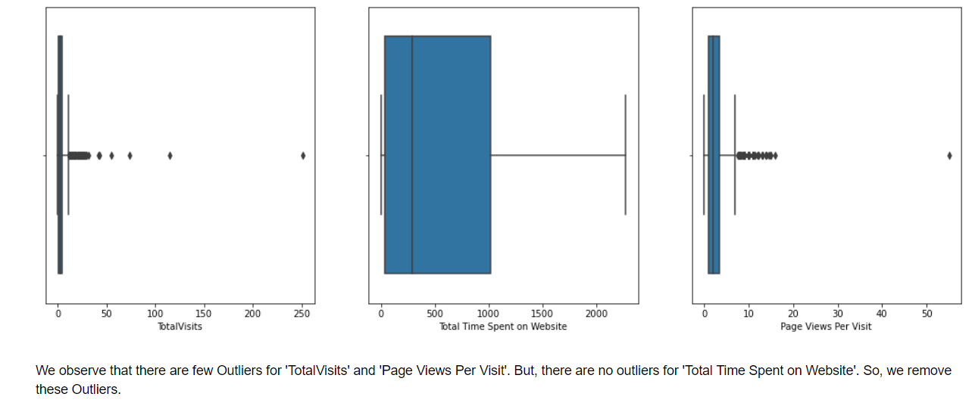
Outlier Treatment using Visualization

Slide 13
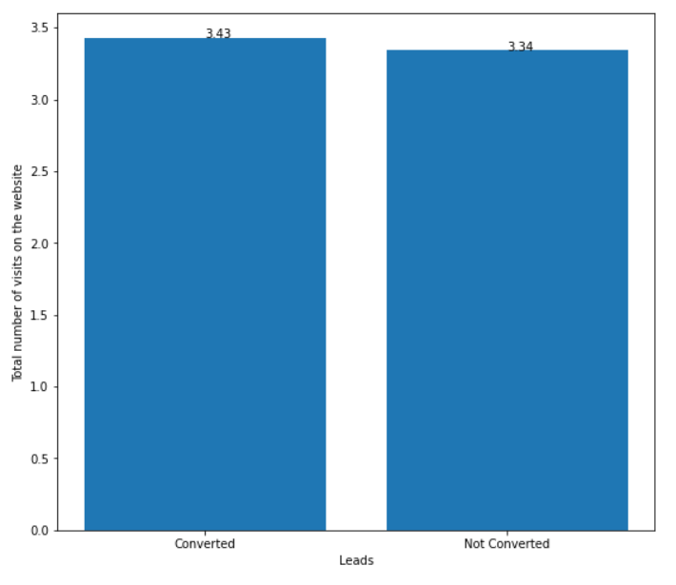
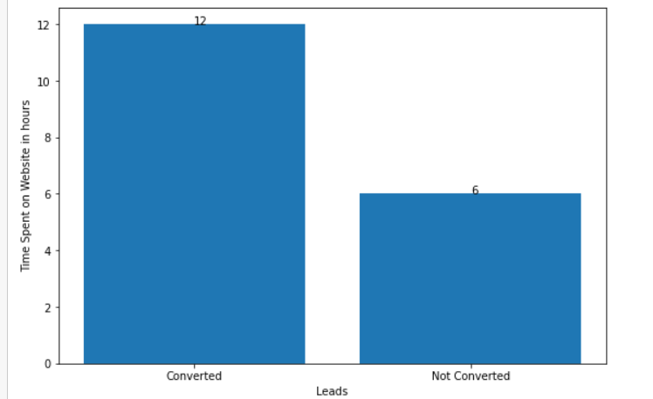
Average Total Visits of the converted and not converted customers
Average Total Time Spent on Website of the converted and not converted customers

Slide 14
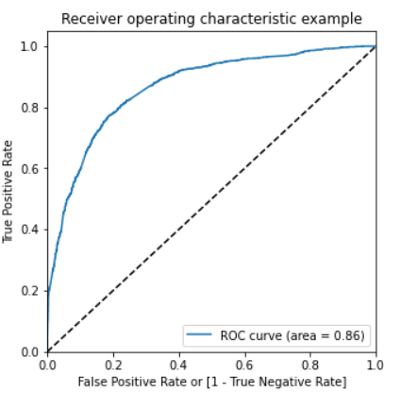
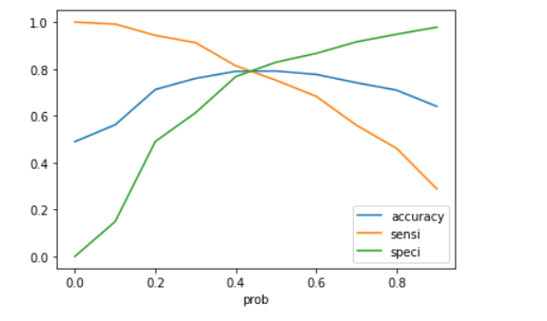
Gini of the model : 0.86
Optimum probability cut off: 0.42
Here we see that the Area under the ROC Curve is 0.86 which in our opinion is quite good.
Accuracy of trained model : 79%

Slide 15
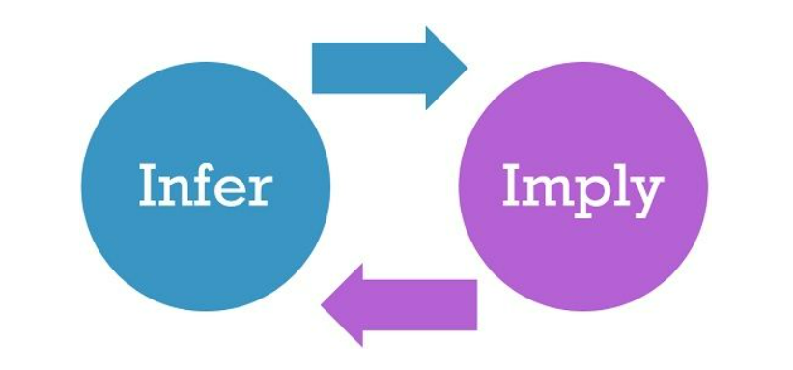
INFERENCE/CONCLUSION

Slide 16
Model Analysis
Overall accuracy on Test set: 78%
Sensitivity of our logistic regression model: 0.7817
Specificity of our logistic regression model: 0.7919
Performance of our Final Model

Slide 17
Inferences from Model
Top 3 variables in model, that contribute towards lead conversion are:
Total Time Spent on Website( more than 12 hours considered as hot lead whereas less than 6 hours are not potential leads)
Last Notable Activity_SMS Sent
Total Visits
Business Insights Derived from our Model

Slide 18
Inferences from Model
Top 3 variables in my model, that should be focused are:
Last Activity_SMS Sent (positively impacting)
Last Activity_Olark Chat Conversation (negatively impacting)
Do Not Email_Yes(negatively impacting)
Business Insights Derived from our Model

Slide 19
Conclusion
Our Logistic Regression Model is decent and accurate enough with 78.7 % Accuracy on Test Set, 78.17 % Sensitivity and 79.19 % Specificity.
We can vary these parameters by varying the cut-off value and thus predict Hot leads based on scenarios like availability of extra resources and vice-versa.

Slide 20
Business Recommendations
X Education Company needs to focus on following key aspects to improve the overall conversion rate:
Total time spent by a candidate on the website can be taken as a measure to understand potential leads so the business needs to increase user engagement on their website since this helps in higher conversion.
Increase on sending SMS notifications since this helps in higher conversion
Get Total visits increased by advertising etc. since this helps in higher conversion
Improve the Olark Chat service since this is affecting the conversion negatively
Concentrate less on customers who opted for “Do not email” option as they are very less likely to be converted to potential leads.

Slide 21


